Slide 1

Module 3 Review
Rayid Ghani

Slide 2
Final Write-Up
Due next Wednesday, December 14

Slide 3
Data and AI Ethics Issues
Privacy
Data Ownership
Bias, Equity, & Fairness
Transparency
Trustworthiness and Accountability

Slide 4
Many Bias Measures: How do we select what we care about?
Statistical/Demographic Parity
Impact Parity
False Discovery Rate Parity
False Omission Rate Parity
False Positive Rate Parity
False Negative Rate Parity
...

Slide 5
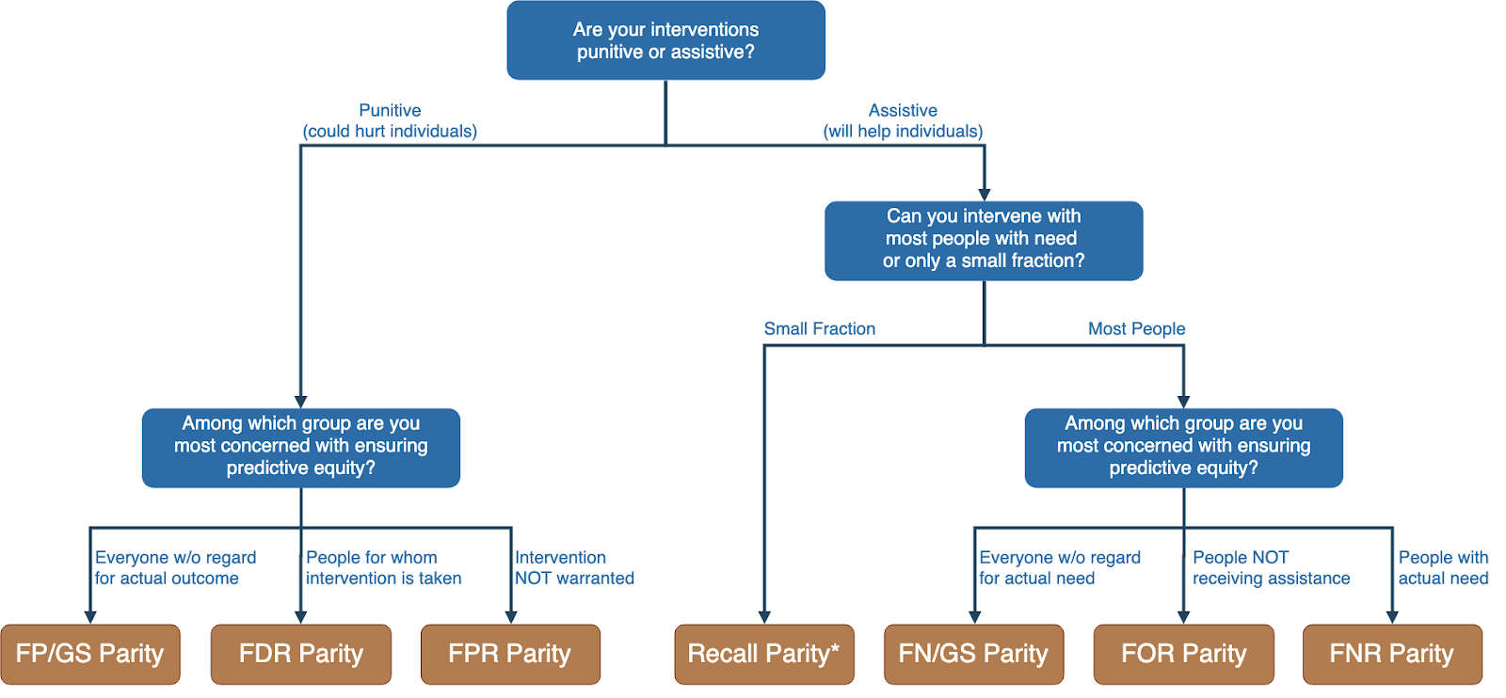
Translating policy goals to fairness metrics

Slide 6
How can we reduce bias in ML models?
Fix the world
Pre-Processing: Fix the input data
Remove sensitive attributes (and correlated ones)
Resample and/or reweight protected groups
In-Processing: Optimize for fairness in model training
Post-Processing
Choose fair models during model selection
Post-hoc adjustments to ‘de-bias’ model scores

Slide 7
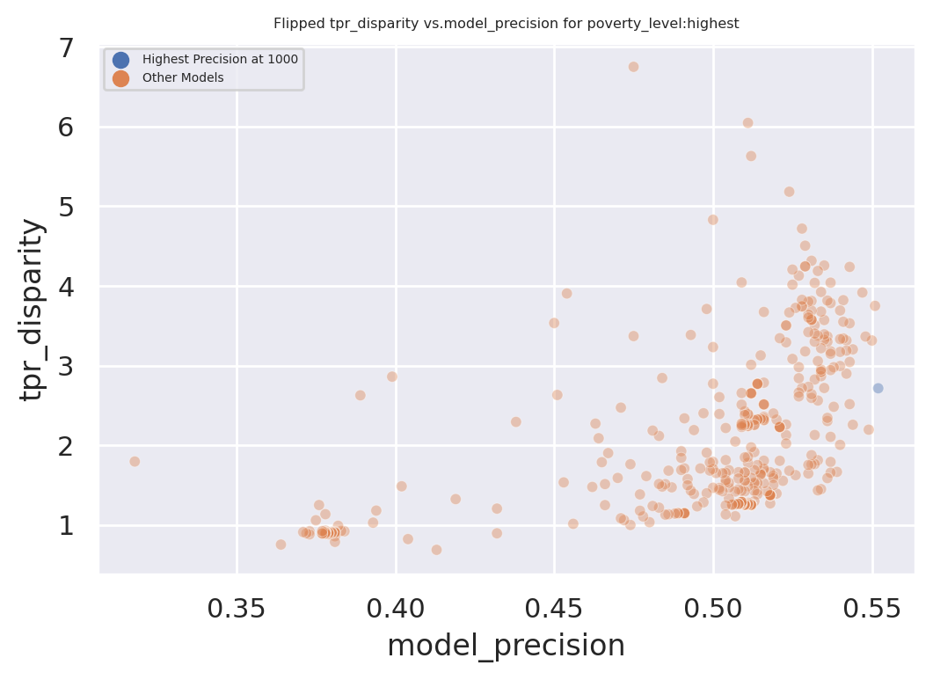
Dual Goals: Fairness and “Accuracy”
Disparity
Our hope:
Fairness-improving
methods can expand this
frontier by adding new
points
Precision@k

Slide 8
Pre-Processing Methods
Looked at removing sensitive attributes and resampling
What are the key assumptions behind each approach?
How well did they work in practice?
Areas for improvement or future research?

Slide 9
In-Processing Methods
Looked at methods from Zafar, and FairLearn
What are the key assumptions behind each approach?
How well did they work in practice?
Areas for improvement or future research?

Slide 10
Post-Processing Methods
Looked at decoupling, score adjustments
What are the key assumptions behind each approach?
How well did they work in practice?
Areas for improvement or future research?

Slide 11
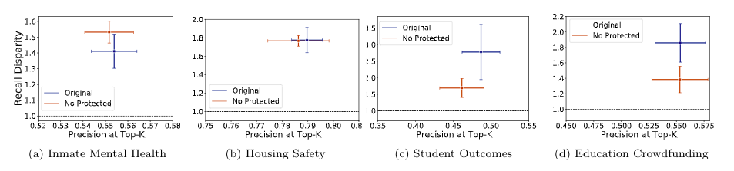
Removing Protected Attribute

Slide 12
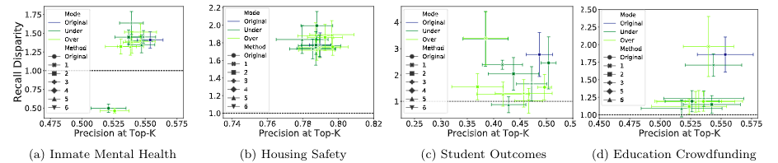
Sampling

Slide 13
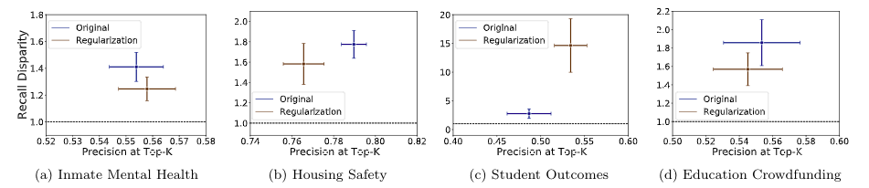
Constrained Optimization (Zafar)

Slide 14
Model Selection
Two options to account for fairness during model selection:
Set a constraint on max acceptable disparity, choose model with highest precision@k among those meeting the constraint (if none do, take the model with disparity closes to the constraint)
Set a constraint on max acceptable loss of precision@k, choose fairest model among those meeting the constraint

Slide 15
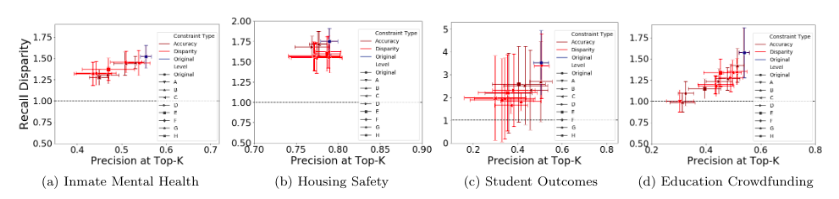
Model Selection

Slide 16
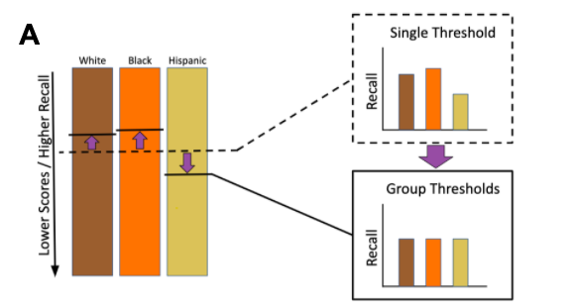
Post-Hoc Adjustments

Slide 17
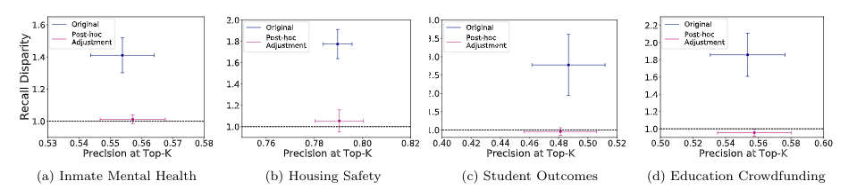
Post-Hoc Adjustments

Slide 18
Methods Considered
Pre-Processing
Remove sensitive attribute
Sampling (several approaches)
In-Processing
Zafar’s constrained optimization
Post-Processing
Model selection
Post-hoc adjustments
Composite models (Dwork)

Slide 19
Composite Models
Idea is models may be under-performing for some subgroups (especially smaller ones), so choose or train models separately based on subgroup performance
Two options for building composite models:
Train separate models using only examples from each group
Train models using all the examples, perform model selection for each group
Model scores not necessarily calibrated, so we combine with the same recall-equalizing thresholds as used in post-hoc adjustments

Slide 20
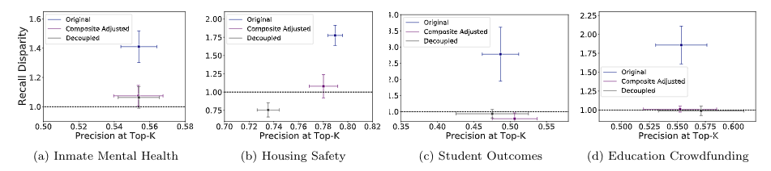
Composite Models

Slide 21
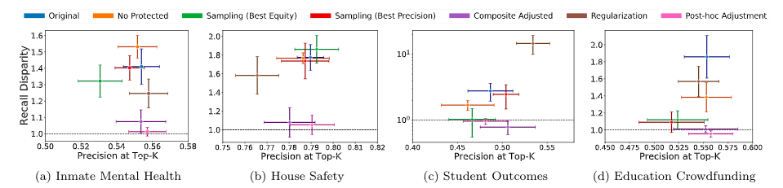
Putting It All Together...

Slide 22
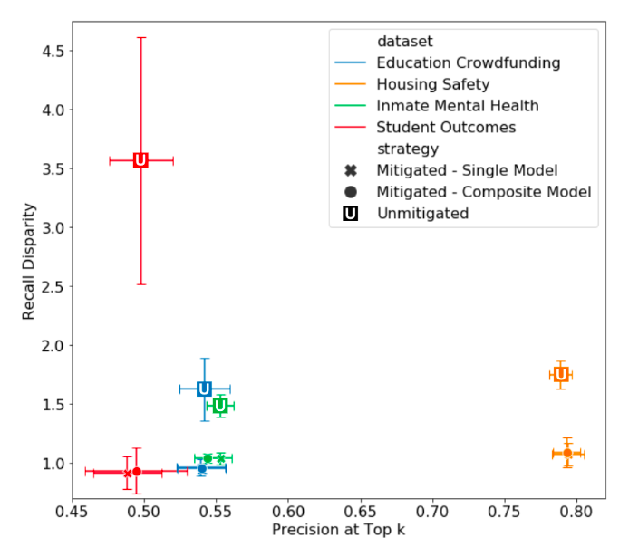
Putting It All Together...

Slide 23
Summary
High variability in performance across methods and contexts
Post-hoc adjustment was only method that consistently improved fairness of model predictions
In these contexts, the adjustments were able to improve fairness without cost to accuracy

Slide 24
Post-Processing
Case Study

Slide 25
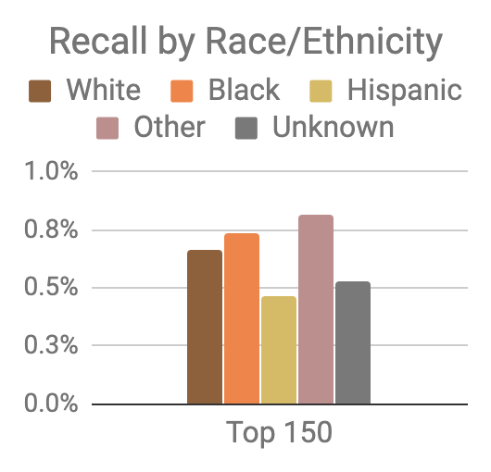
Model was optimized for efficiency, not equity
Top 150 highest risk reasonably balanced between black and white individuals
However, hispanic and unknown race/ethnicity groups very underrepresented

Slide 26
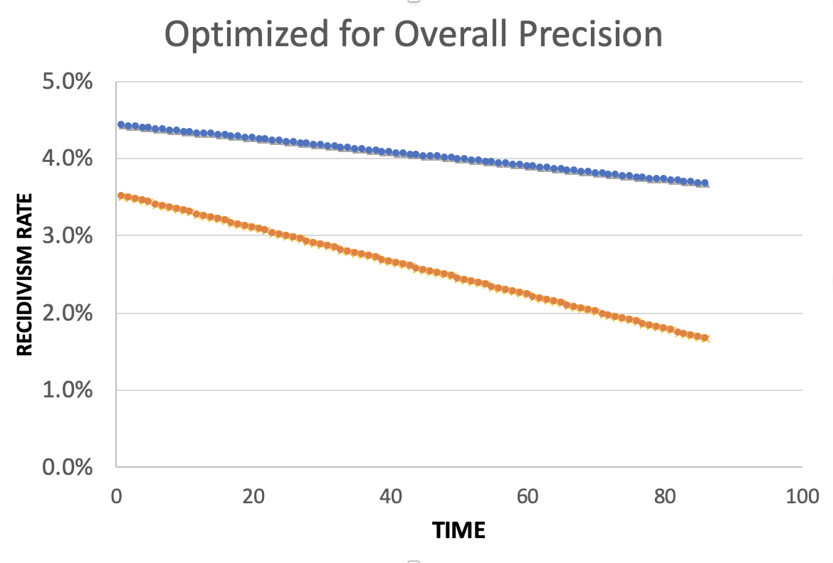
Equality of Predictions vs Underlying Disparities
Widening Gap:
Disparities Getting
Larger Over Time

Slide 27
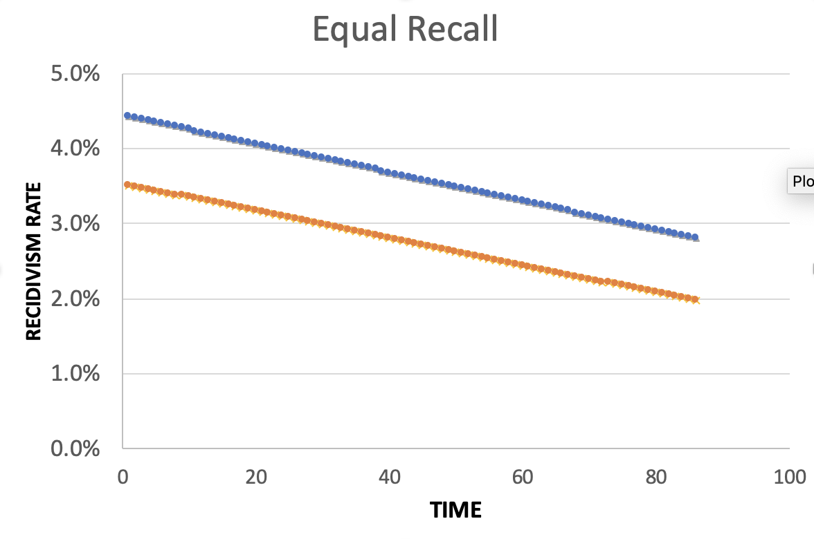
Equality of Predictions vs Underlying Disparities
Parallel Lines:
Disparities Remain
Constant Over Time

Slide 28
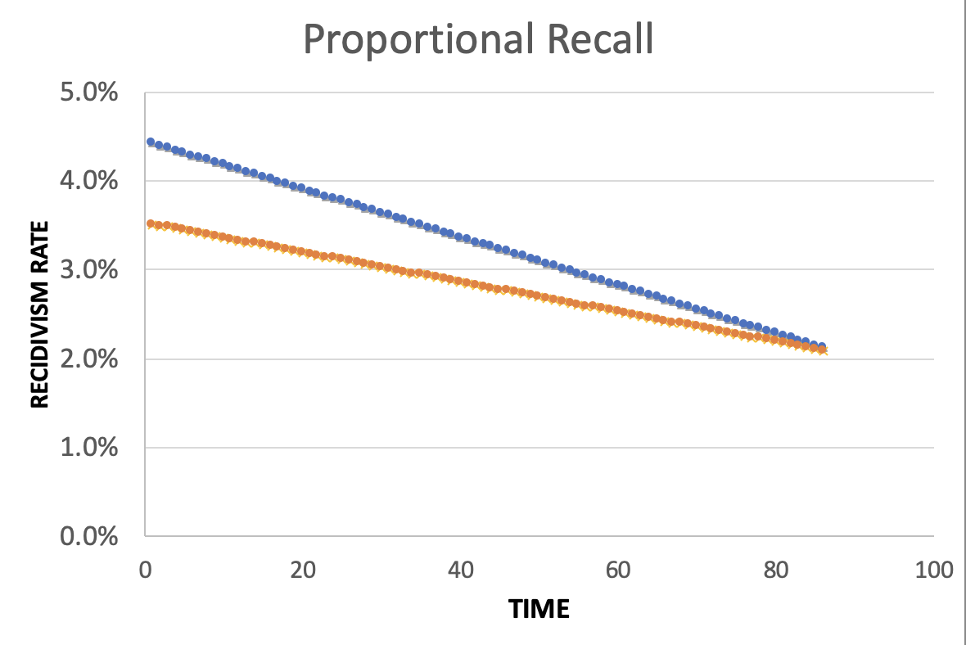
Equality of Predictions vs Underlying Disparities
Converging Lines:
Disparities Decrease
Over Time

Slide 29
Little Equity/Efficiency Trade-Off at Current Scale
Top 150
72.7%
Precision
150
Total Count
Equal
Recall
70.7%
Precision
150
Total Count
Proportional
Recall
70.7%
Precision
150
Total Count

Slide 30
A Few Final Thoughts
Make bias, fairness, and equity an integral part of every project: Scoping, community engagement, metrics, validation, monitoring outcomes
Understand how different phases of the project could lead to downstream bias
All bias metrics are not created equal - use the Fairness Tree to understand your problem/use case and select appropriate metrics
Audit and Explore bias reduction strategies
A perfectly fair model does not mean fair outcomes. Think about the entire system (including actions) and measure outcomes
Compared to what?

